Slide 1




Social Work Leadership Framework: Dissemination

Slide 2
Social Work Leadership Framework: brief facilitator guidance notes [HIDE/ DELETE THIS SLIDE BEFORE USE]
These slides have been designed for facilitators to use in a way which suits whatever audience they are working with.
Time constraints may also affect how the facilitator uses the slide deck.
You can pick and choose which slides to use but we recommend using the slides which outline the four quadrants as a bare minimum (slide nos. 12, 13, 15, 17, 19). The other slides supplement the information or ask participants to interact and consider application of the framework. The slides are presented sequentially and therefore are already in the recommended order of delivery.
The activities and notes are suggested approaches to be adopted or tailored by the facilitator according to audience and time frames for the session.
Suggested prompts to aid interaction and understanding :
Reflect on how this has landed with you.
Describe/explain how this challenges or supports your view of leadership?
What else would you like to know?
How might we take this forward?
How might we enhance awareness of leadership in social work? With social workers? With other professionals?
Which parts feel immediately familiar or intuitive?
Which aspects of the model could you apply tomorrow in your role?

Slide 3

The Social Work Leadership Framework:
Transforming social work through leadership
Session learning objective (s):
Defining leadership and why it is important for social Work
Etc.
Etc.
Notes:
Facilitator should use this slide to outline the focus of the session, the duration and any breaks to be included as well as any other relevant house keeping.
e.g. ‘Welcoming you to an awareness raising session focusing on the Social Work Leadership Framework’.
(If any statistics exist or are made available to share re: awareness of the Social Work Framework then these could be shared here on the title slide also to add interest and draw the audience into the session).

Slide 4
What does leadership mean to you?
Courage Resilience Visionary
Collaborator Networker Resourcer
Creative Thinker Agile Navigator Problem-solver
Decision-maker Change Maker Innovator
Do you see you?
Notes:
Facilitator to stimulate discussion amongst the audience focusing on: Do you see yourself as a leader/ Think about where you see leadership in your own area/ what does leadership means to you? Invites attendees to participate/share.
A white board could be also used to record responses.
The words on screen can be released gradually, used as a prompt to stimulate discussion or shared after to as a reflection of possible responses. Can challenge if attendees voice the perception that they see leadership as only occurring at certain levels/roles. The range of group answers on the whiteboard can remain throughout the session as a reference point to revisit later.

Slide 5
Leadership myths
You only need to think about leadership when you are in a senior management role.
Leaders give orders.
Leaders have special talents others don’t possess.
Notes:
Facilitator should reveal each statement one at a time and invite group to share their views on the above statement e.g. if they are true or false.
Encourage group to justify their responses with examples to support their thinking.

Slide 6
Defining leadership
Leadership is knowing what is required of you and delivering it at the right time.
Rather than attached to a role, leadership is a mindset; the ability to influence, collaborate, and unite people and resources.
Leaders grow new leaders, not followers.
Do you now see you?
Notes:
Facilitator to invite reflections on whether using these modern day leadership perspectives individuals now see themselves more as leaders?

Slide 7
Defining leadership
a. Leadership is an activity, i.e. it is available to everyone
b. Leadership involves influence, i.e. the leader’s effect on others determines their success
c. Leadership occurs in groups, i.e. leaders mobilise others to achieve a purpose
d. Leadership involves common goals, i.e. leaders direct energy to achieving something together
(DoH, 2022)
Notes:
Facilitator shares the statements and asks the invites individual/group reflections on their views on these and then on whether using these modern day leadership perspectives individuals now see themselves more as leaders?

Slide 8
What do leaders do?
Establish Direction (vision and strategy)
Aligning People (communication, commitment and coalitions)
and Motivate (inspiring energising, empowering and meeting unmet needs)
Do you now see you?
Notes:
Facilitator shares slide content and then invites the group to share examples of leadership behaviours across the above areas. In discussing facilitator them prompts them to reflect on whether they are closer to seeing themselves as leaders e.g. do they behave in some/all of these ways in their daily practice? Once again the prompt about whether they see themselves as leaders returns as a reflective tool.

Slide 9





.
The Improving and Safeguarding Social Wellbeing Strategy (2012) identified professional leadership as a key priority for strengthening the profession
Social work leadership not new…..
Following the Good Friday Agreement (1998), leadership reflected the challenges of a post-conflict society.
Early Foundations
(1960s–1980s)
Start of social work education and development of professional standards.
During the Troubles (1968–1998), need for conflict-sensitive leadership.
2012+
Strategic and Collective Leadership Models
The Northern Ireland Post Qualifying
and Training Partnership (1993) NI 1st UK region to establish a post-qualifying partnership between employers and academic institutions.
Notes:
This content can be summarised by the facilitator to map the importance of leadership to the profession. Invites thoughts from the group.
The facilitator should allow time for reading of the content and then ask the group to pinpoint areas of specific interest to them, are there any milestones they would add/ were/weren’t aware of?

Slide 10
Why is leadership important for social work?
‘Professional leadership is critical to inspire, lead and represent the profession’ (SWS, 2012).
Leadership in social work is not optional—it is integral to fulfilling the profession’s purpose (Venning et al., 2025).
Leadership is key to:
- Addressing stress, burn-out, retention challenges (McFadden et al., 2025).
- Guide safe staffing policy and organisational culture (McFadden et al., 2024).
Notes:
Facilitator to ask the group why they think Leadership is needed for the profession.
Anticipated/suggested responses:
To champion social justice and drive systemic change
Support teams in complex, emotionally demanding environments (Tulane School of Social Work, 2024)
Guide ethical decision‑making and uphold professional values (Venning et al., 2025)
Strengthen professional identity and confidence
Improve outcomes for service users and communities
Build organisational and workforce capacity (Martin, 2024)
Navigate evolving policy, political, and societal demands
Many of the skills leaders demonstrate are aligned with Social Work Practitioner skills and Values.
Social work values by definition, do not only require leadership … but define it (Hayes, 2014).
*The content of the slide can be shared before or after this process to prompt feedback or consolidate afterwards.

Slide 11
Social work leadership: Why now?
Workforce planning, succession and career pathways and a review of leadership development in social work highlight the need to clarify distinct social work leadership capabilities (DoH, 2018).
Leadership capacity was referenced in the Social Work Strategy 2012-2022.
Social work leadership is differentiated by the purpose, value base, context and application of relevant evidence and social science knowledge to practice and policy.
Notes:
Facilitator can also put the question to the group-why do they think SW leadership is needed now? Record responses or flipchart paper and share or reveal the slide content and ask them to reflect-agree/disagree.
Round off the introduction by asking the group again if they now see themselves as leaders and why?

Slide 12
Social work leadership: why now?
The Social Work Leadership Framework seeks to equip social workers as leaders not just for today but also for the future.
Leadership is an integral part of the social work journey at every level and stage of your career journey.
The framework exists to embed leadership at all levels of social work practice, ensuring the profession is prepared to lead change and improve services now and in the long term.
Notes:
Or at this slide, facilitator can put the question to the group-why do they think social work leadership is needed now?
Round off the introduction by asking the group again if they now see themselves as leaders and why?
Signpost NISCC FAQs: https://niscc.info/social-work-leadership-framework-frequently-asked-questions/

Slide 13
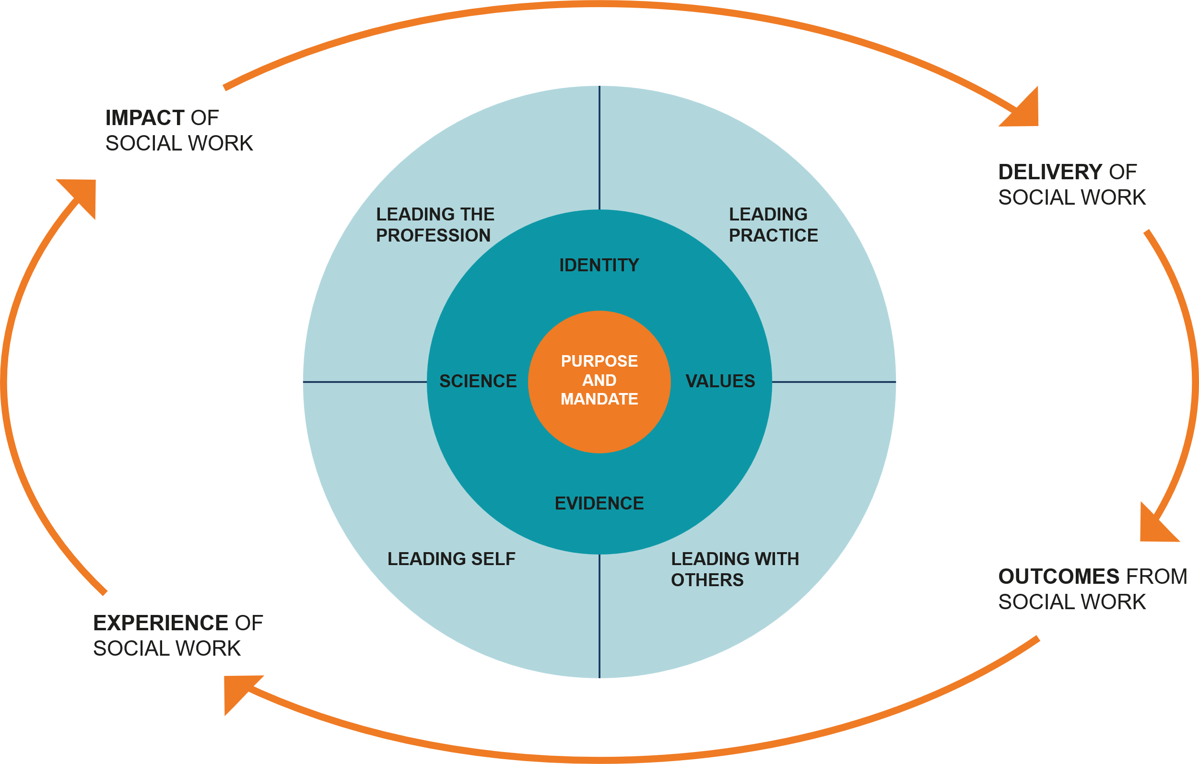
Overview of the Social Work Leadership Framework
“Social Workers need to demonstrate leadership at all levels and across all roles within the profession.”
(Safeguarding Social Wellbeing: Strategy for Social Work)
Social Work Leadership Framework
Notes:
Facilitator to explain:
The Leadership Framework shows the different dimensions of social work leadership and demonstrates all social workers, including you, have a leadership role. It does this by looking at it from four different perspectives (or referred to as ‘domains’ in the Leadership Framework):
Leadership is about leading self. This means taking opportunities to develop the ways you use self-disclosure, empathy and authenticity to enhance working relationships.
Leadership is about leading with others. It’s how you collaborate with social work colleagues, professionals in other fields, service users and communities to achieve better outcomes.
Leadership is about leading practice.
We all have a role to advance how social workers work by adapting to new research and knowledge, societal change, and the findings of inquiries.
Leadership is about leading the profession.
Key to this is when you work in ways that instill trust to advance the reputation of social work, and influence how the profession evolves to meet new challenges.

Slide 14
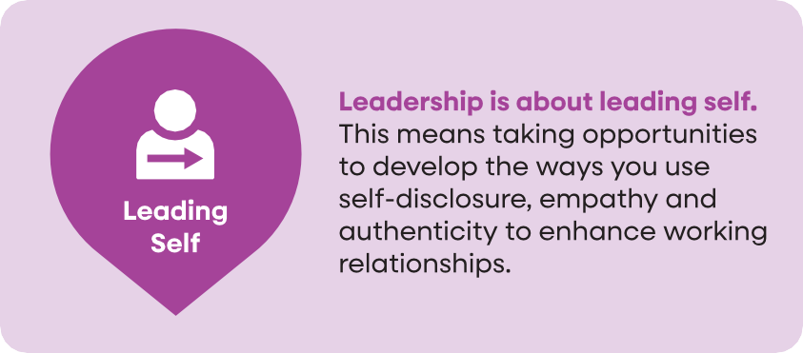
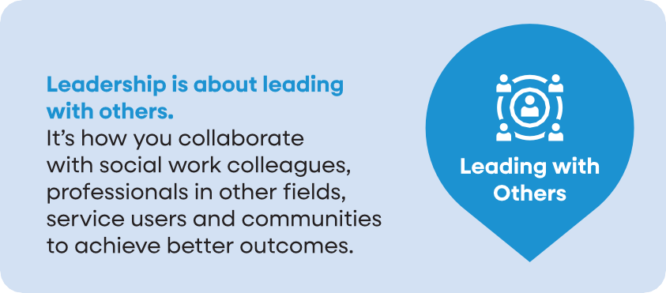
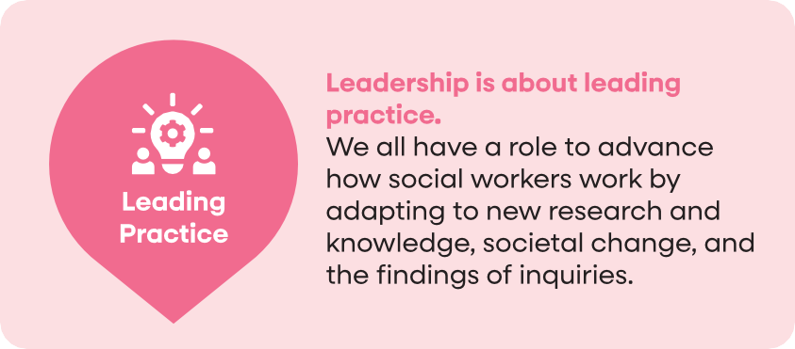
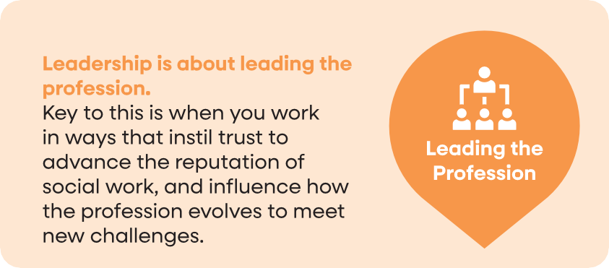



Overview of the Social Work Leadership Framework
Leadership in Social Work
In Northern Ireland

Slide 15
Leading self

Slide 16


Leading self
Leadership is about leading self. This means taking opportunities to develop the ways you use self-disclosure, empathy and authenticity to enhance working relationships.
Skills/capabilities:
Authenticity
Emotional intelligence
Self-awareness
Self-care
Self-discipline
To access the ‘Leading self’’ learning module, scan the QR code, or follow the link below:
https://learningzone.niscc.info/leadership-in-social-work-in-northern-ireland/
Notes:
Facilitator to highlight the learning modules which are available on the Learning Zone for this domain:
To access the Leading Self learning module, scan the QR code, or follow the link below:
https://learningzone.niscc.info/leadership-in-social-work-in-northern-ireland/

Slide 17
Leading self: Exercise
Take five mins to think of a challenging work situation when self-care was important.
Small group discussion (only share what is comfortable, in accordance with confidentiality):
  How did you feel personally?
  How did you manage this professionally?
  How did you seek support?
  How did your response link to the skills/ capabilities of ‘leading self’?
  How did this improve or develop your practice?
Notes:
Facilitator to emphasize importance of participants being mindful of what they disclose, ensuring the example is one that won’t impact negatively on them and the group, and emphasizing the importance of maintaining confidentiality.
The timing of the exercise can be adapted to fit the time available for the overall session.
Summing up- facilitator to highlight that challenging situations, push us outside our comfort zone but give us the opportunity to show leadership and to develop the skills and capabilities of leading self
Facilitator also to emphasize that regular reflection on self and feedback from others plays an important role in leading self
Role-modelling the skills and capabilities of ‘leading self’ and sharing your experiences will demonstrate leadership behaviours and guide others in their leadership journey

Slide 18




Leading with others

Slide 19
Leading with others
Leadership is about leading with others. It’s how we collaborate with social work colleagues, professionals in other fields, service users and communities to achieve better outcomes.
Skills/capabilities:
Co-production of services.
Communication and information sharing.
Constructive challenge and critical thinking.
Connecting and network development.
Participation and partnership working.
Notes:
Facilitator to explain that:
Building effective relationships and networks of practice with others based on trust, honesty and reliability is core to a social work leadership approach. Social workers show leadership as part of a team, organisation or community of practice. You don’t have to be a manager to be a leader.
Co- Production. Recognising that social workers can hold power and authority- use of power, sharing power. What does co-production look like? The importance of working in partnership with people who have lived experience of the issues to find solutions..
Constructive challenge and critical thinking. Not accepting the status quo. How do you influence for positive change and embed change into systems? The value of system thinking and design – who is impacted who has influence?. Who is part of the solution? Who or what is part of the problem.
Connection and network development. Understanding the roles of other professionals across Health and Social care, communities and the Community and Voluntary sectors and wider professions. Build your networks and respect them.
Participation and partnership working. Boundary spanning approaches as part of leadership. Working beyond silos to build meaningful partnerships with others.

Slide 20
Leading with others: Exercise
Reflective exercise
The capacity to lead is as important in frontline practice as it is in management roles. Think of a pressing societal issue that is evident in your area of practice- e.g. mental health of school age children, homelessness for young people leaving care, increasing levels of domestic violence.
As a group identify an issue to explore how you would lead with others to try to respond to the problem:
  Who or what is part of the problem?
  Who is part of the solution?
  How do you influence for change and embed change into systems?
Notes:
Reflective exercise notes for presenter: 15 minute exercise. Groups can explore a topic like mental health and share how it impacts on their area of practice. Allow some initial time (5 mins) for the group to share what that looks like for each of them- practice areas across different stages of the lifespan, levels of complexity and work location. Group should choose/ agree one area of practice to focus on- eg mental health of young men and then discuss the questions posed by the exercise. 10 minutes and short feedback.
This can also be a shorter 10 minute exercise if completed in pairs.
Recommended further activities for group
Deepen your knowledge though reading and sharing these additional resources:
Leadership in Social Work in Northern Ireland - NISCC Learning Zone
Social Work and Community Development; Reflections, DOH April 2023
Social Work and Co-Production; Reflections, DOH Nov 2021
Social Care Council Learning Zone Resources including:
Community Development Resource Community Development in Social Work - NISCC Learning Zone
Loneliness the Role of Social Work Loneliness: The Role of Social Work - NISCC Learning Zone
Human Rights Human Rights for Social Workers - NISCC Learning Zone

Slide 21
Leading practice

Slide 22
Leading practice
Leadership is about leading practice. We all have a role to advance how social workers work by seeking out, adapting to or contributing to new research and knowledge, responding to societal change, and implementing learning from the findings of inquiries. We do this to ensure that social work practice is responsive and effective
Skills/capabilities:
Reflective practice and supervision.
Learning, development and change management.
Innovation, improvement and piloting.
Governance and accountability systems.
Measurement and evaluation.
To access the Leading Self learning module, scan the QR code, or follow the link below:
https://learningzone.niscc.info/leadership-in-social-work-in-northern-ireland/
Notes:
Facilitator to explain that:
Reflective practice and supervision are central to social work practice and can help us to see the connections across our caseload ,to service delivery and to wider societal issues. Being reflective means not accepting the status quo and represents innovative problem solving and collaborating to effect change.
Continuous learning and development ensure our practice is in keeping with new and emerging knowledge.
Innovation, improvement and piloting enables practitioners at all levels to bring about change alongside those who draw on social work and social care services for the wellbeing of individuals. Quality improvement gives the people closest to the issues the time and permission, skills and resources they need to solve problems. The Reginal QI in SW programme is one example of how social workers can explore how to make small and meaningful change and improvement.
The way the organisation that you work within is managed has a profound impact on the well-being and quality of life of individuals within our care, governance provides a framework for this.
Measurement & evaluation helps us to understand the value and impact of change and the benefit for people who access services or support. When evaluation is done well it can help solve problems, inform decision making and build knowledge.

Slide 23
Leading practice: Exercise
Reflective exercise
Thinking of your area of practice;
Are there opportunities to change or develop practice? How have you identified these?
How have you engaged with this? Is this an individual or part of a team/ group?
How could the leadership framework help you lead in this area?
Notes:
Facilitator to encourage the group to work in pairs or small groups and discuss the three bullet points. Recommended time10 minutes (however timings can be adapted to suit group size and time available).
Suggested prompts to encourage /expand on discussion;
How do our current systems enable or block Leading Practice? Think about one system that supports excellence and one system that unintentionally restricts it.
Which of the five capability areas identified as part of leading practice ( previous slide) is your strength? Which presents more of a challenge? Why is this?
Feedback from the group 5 minutes.
Recommended further activities for the group
-Read more about the SWLF and complete the short online module about the Leadership Framework. Introduce the rest of your team to this module. Leadership in Social Work in Northern Ireland - NISCC Learning Zone
-Share good practice
-Utilise CPD opportunities to develop knowledge and skills including PiP Approved courses and programmes eg Research Methods, QI, Leading Social Work. NI PQ Accredited Programmes/Pathways for full list.
-Identify what steps you could take in the next month to strengthen Leading Practice in your area of social work.

Slide 24
Leading the profession

Slide 25

Leading the profession
Leadership is about leading the profession. Leadership in social work is expected from all practitioners, not only those in senior roles, promoting collective responsibility.
Key to this is working in ways that instil trust to advance the reputation of social work, and influencing how the profession evolves to meet new challenges.
Skill/capabilities:
Strategic analysis.
Setting vision and direction (policy, strategy).
Inspiring shared purpose.
Advocacy, challenge and influence.
Upholding standards, ethics and rights.
Notes:
Facilitator to ask audience to think about each of the skills and capabilities in turn and how they are used to lead the profession.
Strategic analysis – Being aware of emerging and ongoing societal issues and being able to evaluate and understand the internal and external factors which influence the delivery of social work is pivotal to ensuring needs are met appropriately.
Setting vision and direction (policy, strategy) –this applies across all levels, setting vision and direction within teams can start with any member of the team who is able to highlight appropriate ways forward for individuals, teams and organisations – this can influence policy and strategy at higher levels. Given the changes in societal trends and emerging issues which impact on wellbeing and safeguarding, the profession of social work has a strategic role in shaping public policy, influencing the allocation of resources and providing guidance to address ethical dilemmas.
Inspiring shared purpose – be this within social work or across disciplines, bringing people together for a common goal is a leadership skill.
Advocacy, challenge & influence -Leading the Profession is the contribution each social worker makes to the reputation and influence of social work as a discipline. The work social workers do in advocating (for service users, for the profession) demonstrates leadership. Equally challenging decisions, injustices, discrimination and oppression mean putting your head above the parapet and leading for the benefit of those we work with and society
Upholding standards, ethics and rights – the skill of maintaining social work values and continuing to improve social work services through self, others , practice all contribute to leading the profession

Slide 26
Leading the profession
What does it look like? Key functions and responsibilities
Shaping professional standards​: Social workers influence standards through policy consultation and adherence to ethical frameworks for effective practice.​
Modeling core social work values​: Leadership includes demonstrating empathy, accountability, respect for diversity, and commitment to social justice.​
Promoting research and evidence-informed practice​: Encouraging research integration and critical reflection strengthens the profession’s response to challenges.​
Advocacy and public engagement​: Social workers advocate for their profession and raise public awareness about social issues and policies.
“Leadership is all about ‘doing the right thing’ and management is about ‘doing things right.”’
(Peter Drucker, The Practice of Management (2006).
Notes:
Facilitator to talk through each point. Thinking about the outer circle of the model in terms of impact, experience of social work, outcomes and delivery the facilitator can highlight the following and ask some prompt questions
Impact of social work is achieved by the development and implementation of policies, strategies and legislation led by the Office of Social Services in the Department of Health, and in consultation with social work leaders – how does this sit with this part of the model?
Experience of social work by service users and carers who will engage directly with social work practitioners and feel first-hand the type of contribution social work has made to their personal wellbeing and safety – how does leading the profession in the ways discussed, ensure a better experience?
Outcomes from social work which are achieved through relationships- at a societal, organisational and individual level. When looking at the key functions and responsibilities on the slide, what the opportunities and challenges?
Delivery of social work is determined by the employer organisations in a range of settings who create the conditions in which social workers are deployed to achieve their purpose and mandate – how you do see your role as someone leading the profession in influencing the conditions to do better for service users and carers?
Facilitator to also ask them to consider how the model fits with the NI Social Care Council Standards of Conduct and Practice for Social Workers.

Slide 27
Leading the profession: Exercise
An example I’ve observed…
And/or…
My own leadership contribution…
Notes:
Here are two short, practical exercises (each 5–10 minutes) designed to help participants explore the Leading the Profession domain in an engaging, reflective way. timings are adaptable to suit the size of the group or length of the session.
They are fully self‑contained and suitable for team meetings, workshops, supervision groups, or leadership development sessions.
Facilitator to emphasize importance of participants being mindful of what they disclose, ensuring the example is one that won’t impact negatively on them and the group, and emphasizing the importance of maintaining confidentiality.
Exercise 1 (5–10 min): “An Example I’ve Observed”
Purpose:
To prompt participants to recognise real examples of Leading the Profession in action and to analyse what makes them effective.
Instructions:
1. Individual Reflection (3–5 min)
Ask participants to think of one example where they observed a colleague, manager, educator, or practitioner demonstrating “Leading the Profession.”
This could be someone who:
Advocated for professional standards or ethics
Influenced policy, practice, or service development
Modelled social work values publicly or across teams
Shared evidence-informed insights to shape decision-making
Promoted the identity and credibility of the social work profession
Reflection prompts:
What exactly did they do?
How did their actions strengthen or uplift the profession?
What impact did it have—on individuals, teams, or the wider system?
Which aspects of the Social Work Leadership Framework do you see reflected?
2. Pair or Triad Discussion (3–5 min)
Ask participants to briefly share their example with a partner or small group.
Prompts for discussion:
What made this “leading the profession” rather than simply “leading practice”?
What qualities or behaviours stood out?
What can we learn from this example?
Outcome:
Participants gain a concrete understanding of what “Leading the Profession” looks like in reality, making the domain feel more accessible and observable.
Exercise 2 (5–10 min): “My Own Leadership Contribution”
Purpose:
To help participants identify how they personally demonstrate leadership at a professional level—no matter their role or seniority.
Instructions:
1. Silent Reflection / Writing (3–5 min)
Ask participants to write down an example from their own practice where they demonstrated “Leading the Profession.”
This could be something large or small, such as:
Sharing research or best practice to influence colleagues
Advocating for improvements in service standards
Contributing to a practice forum, working group, or professional network
Modelling social work values in a way that influenced others
Supporting student learning or mentoring colleagues
Helping shape organisational policy or guidance
Promoting the identity and purpose of social work
Reflection prompts:
What did I do? Why did I do it?
How did this contribute to the wider profession—not just my immediate role?
What values or principles was I drawing on?
What difference—small or large—did it make?
Encourage participants to identify even subtle examples; many don’t realise they are already “leading the profession.”
2. Optional Sharing (3–5 min)
Invite participants to share one insight with the group or in pairs:
What did you learn about your own leadership?
How might you build on this in the future?
What opportunities do you see to lead the profession going forward?
Outcome:
Participants recognise that “Leading the Profession” is not only for senior managers—it's something all social workers can and do contribute to.

Slide 28
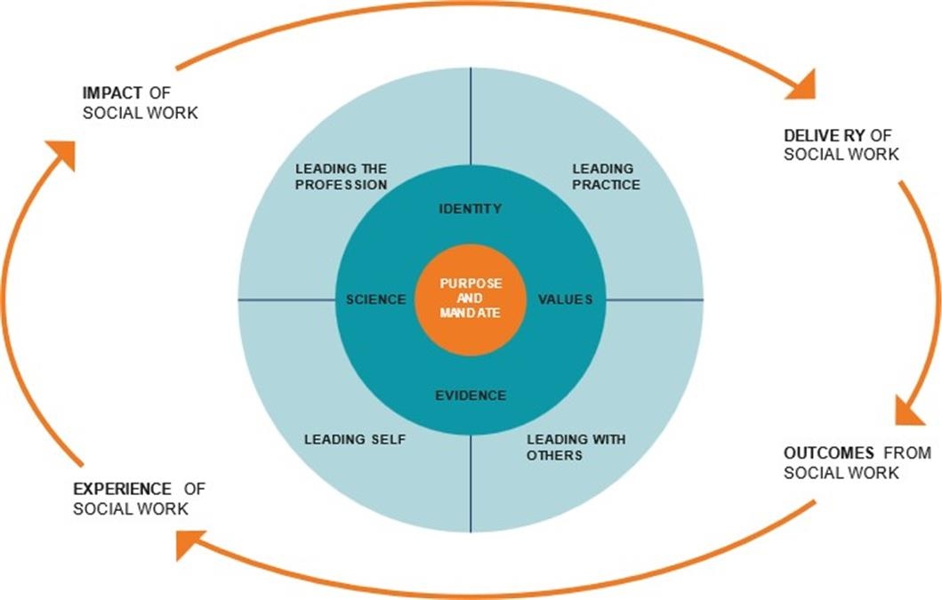
To conclude…
How are you going to bring this into your practice?
Opportunities and challenges
What might you do differently as result of today ?
Opportunities and challenges
Notes:
Discuss the questions on the slide with the participants in order to help them devise a plan for the future and to help them start to align the model with their work, their engagement with service users and carers, their interactions with colleagues and other professionals.
Encourage them to consider this in the light of the societal, organisational, political and economic contexts in which social work takes place in Northern Ireland.
You may wish to ask them to outline 3 actions they are going to take away.

Slide 29



Thank you…any questions?
To access all resources developed, please follow the link below, or scan the QR code.
https://learningzone.niscc.info/leadership-in-social-work-in-northern-ireland/
Leadership in Social Work
In Northern Ireland

Slide 30
References
Haynes, K.S. (2014) Social Workers as Leaders. Social Work Today. Available at: https://www.socialworktoday.com/archive/exc_040714.shtml.
McFadden, P., MacLochlainn, J., Naylor, R., McColgan, M., McGrory, S., Nicholl, P., Kirby, K., Schroder, H., Currie, D., Mullineux, J.C. & Mallett, J. (n.d.) Older people’s social work safe staffing supply and workforce demands analysis: A case study from Northern Ireland. School of Social Sciences, Education and Social Work / Queen’s Business School. Available at: https://pure.qub.ac.uk/en/publications/older-peoples-social-work-safe-staffing-supply-and-workforce-dema/.
McFadden, P., McColgan, M., MacLochlainn, J., Davies, H., Kirby, K., Currie, D., Schroder, H., Nicholl, P., McGrory, S., Naylor, R., Kirby, K., Mullineux, J. & Mallett, J. (2024) Safer and Effective Staffing Research and Policy Development Older People’s and Children’s Social Work in Northern Ireland: Report 1 – The Starting Point: Baseline Analysis. Advance online publication. Available at: https://pure.ulster.ac.uk/ws/portalfiles/portal/164928887/REPORT_ONE_Safe_Staffing_Research_and_Policy_Development_in_Older_People_s_Social_Work_Children_s_Services_3_.pdf.

Slide 31
References
Venning, A., Morley, C. & Newcomb, M. (2025) ‘Reimagining leadership in social work: A call for a distinctive activist approach to social work leadership’, The British Journal of Social Work, 55(8), pp. 3935–3954. Available at: https://academic.oup.com/bjsw/article/55/8/3935/8203661
Tulane School of Social Work (2024) Transformative Leadership in Social Work. Available at: https://socialwork.tulane.edu/blog/transformative-leadership/
Martin, H. (2024) Leadership in social work. Iriss. Available at: https://www.iriss.org.uk/sites/default/files/2024-02/iriss-sws-leadership-social-work.pdf
Department of Health (2012) Improving and safeguarding social wellbeing: A strategy for social work in Northern Ireland. Available at: https://www.health-ni.gov.uk/publications/improving-and-safeguarding-social-wellbeing-strategy-social-work-northern-ireland

Slide 32
References
Department of Health (2018) Improving and Safeguarding Social Wellbeing: Stage 2 Progress Report. Belfast: Department of Health. Available at: https://www.health-ni.gov.uk/publications/improving-and-safeguarding-social-wellbeing-strategy-social-work-northern-ireland
Department of Health (2022) Social Work Leadership Framework. Belfast: Department of Health. Available at: https://niscc.info/app/uploads/2022/09/Social-Work-Leadership-Framework-final-version-15-April-22.pdf

